Slide 1

Data Structure Visualization
Data Structure implementaion using java

Slide 2
- Neil Armstrong

Slide 3
Your best quote that reflects your approach… “It’s one small step for man, one giant leap for mankind.”
- Neil Armstrong

Slide 4
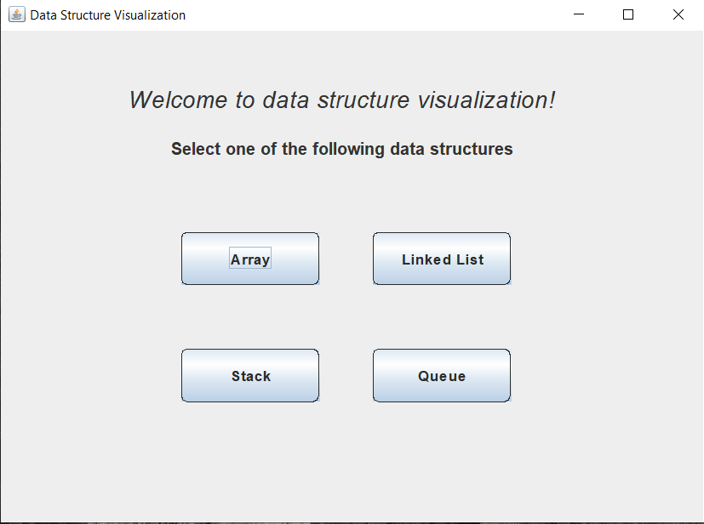
Project entry window
When the user runs the program, the start window of the program appears.
Here, the user is capable of selecting different data structures and some with different implementations to help selecting “best” data structure.
The user can enter either strings or integers in his/her selected data structure and they are informed when something goes wrong.

Slide 5
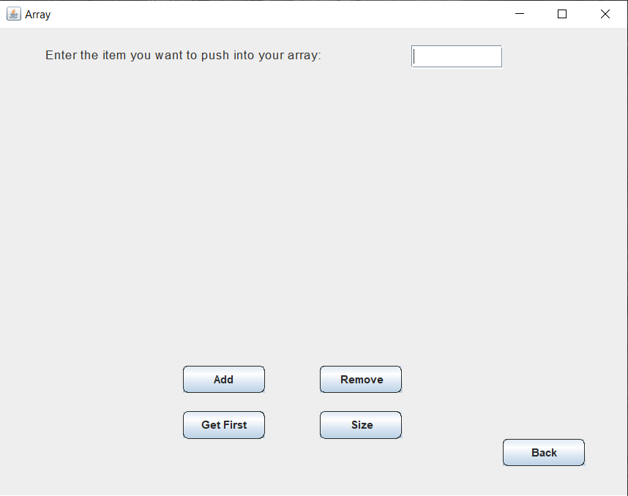
Array Data Structure
If the user selects the array data structure, a window will appear where the user could do some operations on that data structure.
If the user is to choose to add an item, he/she needs to enter that item in the text field.
// aktb el performance

Slide 6
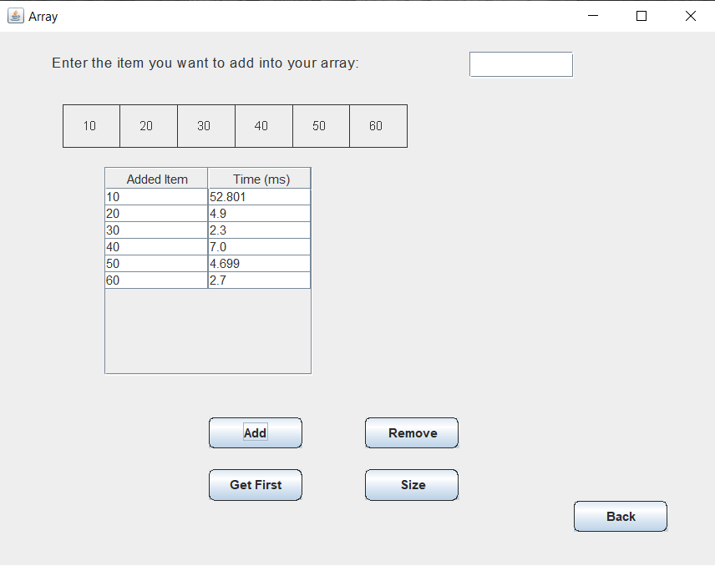
Array Data Structure (Cont’d)
If, for example, the user enters the numbers from 10 to 60, he/she will be able to see their data and the time taken to perform each insertion operation.
We need to mention that the insertion operations happen in the last place available in the array.

Slide 7
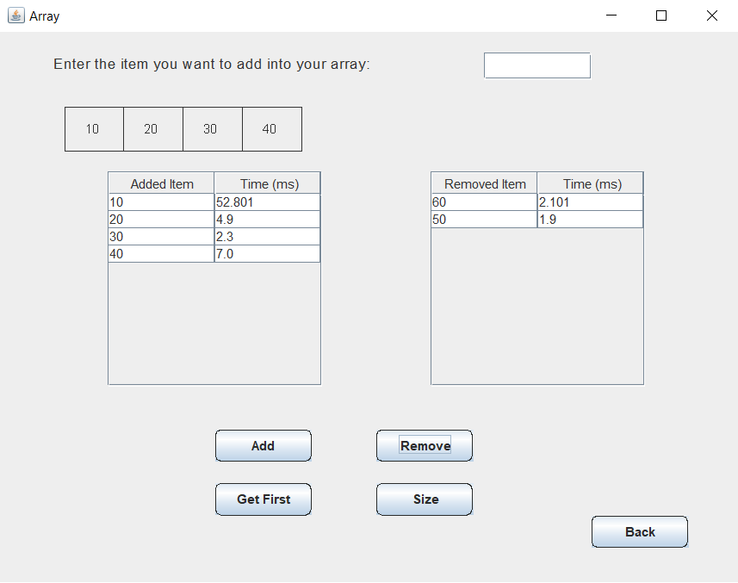
Array Data Structure (Cont’d)
If, for example, the user performs the removal operation twice, he/she will be able to see their updated array data and the time taken to perform each removal operation.
We need to mention that the removal operations happen in the last, actually filled position in the array.

